Slide 1
Process Synchronization-1 Synchronization Tools

Slide 2
Review: Producer-Consumer Problem
A producer process "produces" information "consumed" by a consumer process.
  unbounded-buffer places no practical limit on the size of the buffer.
  bounded-buffer assumes that there is a fixed buffer size.
producer
consumer

Slide 3
Review: Producer – Consumer Problem
Consider that “Does it work correctly?
#define BUFFER_SIZE 10
typedef struct {
DATA data;
} item;
item buffer[BUFFER_SIZE];
int in = 0;
int out = 0;
int counter = 0;
item nextProduced;
while (TRUE) {
  while (counter == BUFFER_SIZE);
  buffer[in] = nextProduced;
  in = (in + 1) % BUFFER_SIZE;
  counter++;
}
PRODUCER
item nextConsumed;
while (TRUE) {
  while (counter == 0);
  nextConsumed = buffer[out];
  out = (out + 1) % BUFFER_SIZE;
  counter--;
}
CONSUMER

Slide 4
How does it work?
Processes can execute concurrently
  May be interrupted at any time, partially completing execution
Concurrent access to shared data may result in data inconsistency
  For example: There is an integer counter that keeps track of the number of full buffers which is incremented by the producer and is decremented by the consumer.

Slide 5
Race Condition
counter++ could be implemented as
register1 = counter
register1 = register1 + 1
counter = register1
counter-- could be implemented as
register2 = counter
register2 = register2 - 1
counter = register2

Slide 6
Race Condition
Consider this execution interleaving with “counter = 5” initially:
S0: producer execute register1 = counter
{register1 = 5}
S1: producer execute register1 = register1 + 1
{register1 = 6}
S2: consumer execute register2 = counter
{register2 = 5}
S3: consumer execute register2 = register2 – 1
{register2 = 4}
S4: producer execute counter = register1
{counter = 6 }
S5: consumer execute counter = register2
{counter = 4}

Slide 7
Race condition
The value of counter may be either 4 or 6, where the correct result should be 5.
Race condition
  The situation where several processes access and manipulate shared data concurrently, the final value of the shared data depends on which process finishes last.
Maintaining data consistency requires mechanisms to ensure the orderly execution of cooperating processes
  Concurrent processes must be mutual exclusion, i.e. if one process is using a shared variable or file, the other processes will be excluded from doing the same thing.

Slide 8
Today’s topic
The Critical-Section Problem
Peterson’s Solution
Synchronization Hardware
Synchronization Software components
  Mutex Locks
  Semaphores
  Monitors
Liveness

Slide 9
Critical Section Problem
Consider system of n processes {p₀, p₁, … p_{n-1}}
Each process has critical section segment of code where the shared data is accessed
  Process may be changing common variables, updating table, writing file, etc
  When one process in critical section, no other may be in its critical section
Critical section problem is to design protocol to solve this

Slide 10
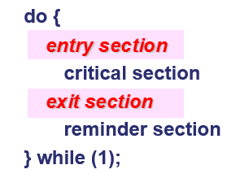
Critical Section
General structure of process P_{i}
Each process must ask permission to enter critical section in entry section, may follow critical section with exit section, then remainder section

Slide 11
Solution to Critical-Section Problem
1. Mutual Exclusion - If process P_{i} is executing in its critical section, then no other processes can be executing in their critical sections
2. Progress - If no process is executing in its critical section and there exist some processes that wish to enter their critical section, then the selection of the processes that will enter the critical section next cannot be postponed indefinitely
3. Bounded Waiting - A bound must exist on the number of times that other processes are allowed to enter their critical sections after a process has made a request to enter its critical section and before that request is granted

Slide 12
Critical-Section Handling in OS
Two approaches depending on if kernel is preemptive or non-preemptive
  Non-preemptive – runs until exits kernel mode, blocks, or voluntarily yields CPU
    Essentially free of race conditions in kernel mode
  Preemptive – allows preemption of process when running in kernel mode
    Must design carefully to ensure data consistency

Slide 13
Today’s topic
The Critical-Section Problem
Peterson’s Solution
Synchronization Hardware
Synchronization Software components
  Mutex Locks
  Semaphores
  Monitors
Liveness

Slide 14
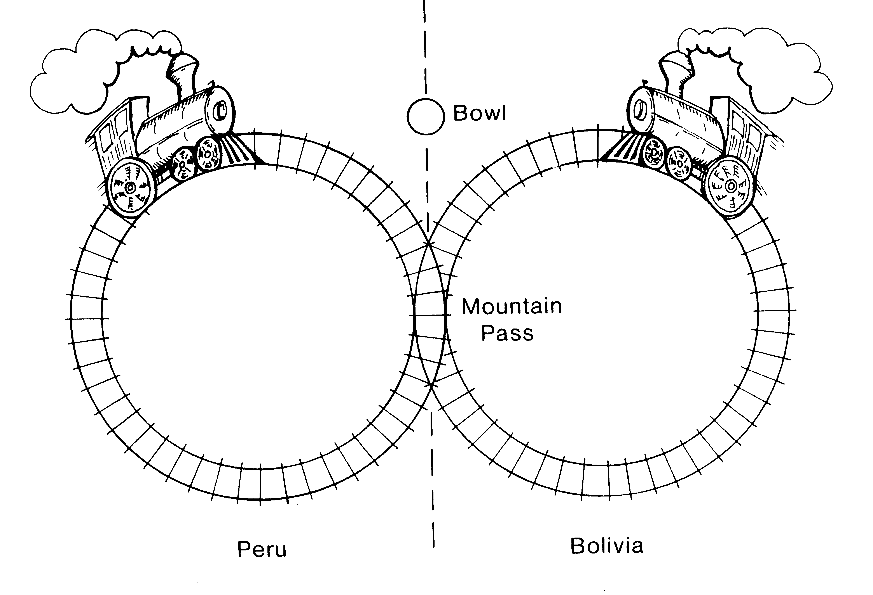
A similar problem: railways in the Andes
High in the Andes mountains, there are two circular railway lines. One line is in Peru, the other in Bolivia. They share a common section of track where the lines cross a mountain pass that lies on the international border (near Lake Titicaca?).
Unfortunately, the Peruvian and Bolivian trains occasionally collide when simultaneously entering the common section of track (the mountain pass). The trouble is, alas, that the two trains are both driverless, and they can only drive follow their own tracks.
How can they prevent collisions?

Slide 15
Railways in the Andes – method 1
One signal light
– crashed again !
If the signal light is turned off, the train turns it on, indicating that the train is entering the pass; once the train has cleared the pass, it turns off the signal light, indicating that the pass is no longer being used.
Signal light
If a train arriving at the pass finds the signal light is turned on, it will wait at the entry and repeatedly takes a rest and rechecks the signal light until it finds the light is turned off. Then the train turns on the signal light and drives into the pass.
Notes:
方法一：
They set up a large bowl at the entrance to the pass. Before entering the pass, a driver must stop his train, walk over to the bowl, and reach into it to see if it contains a rock.
If the bowl is empty, the driver finds a rock and drops it in the bowl, indicating that his train is entering the pass; once his train has cleared the pass, he must walk back to the bowl and remove his rock, indicating that the pass in no longer being used. Finally, he walks back to the train and continues down the line.
If a driver arriving at the pass finds a rock in the bowl, he leaves the rock there; he repeatedly takes a siesta and rechecks the bowl until he finds it empty. Then he drops a rock in the bowl and drives his train into the pass.
A smart graduate from the University of La Paz (Bolivia) claimed that subversive train schedules made up by Peruvian officials could block the train forever. The Bolivian driver just laughed and said that could not be true because it never happened. Unfortunately, one day the two trains crashed.

Slide 16
Algorithm 1 – shared flag
Shared variables
  boolean flag; ⇒ initially flag = false.
  flag = true; ⇒ a process want to enter its critical section
Process P_{i}
No mutual exclusion.
do {
while (flag) ;
flag = true;
/*critical section*/
flag = false;
/*remainder section*/
} while (1);

Slide 17
Railways in the Andes – method 2
One signal light
– alternatively enter !
The Bolivian train must wait at the entry to the pass until the signal light is turned off, drive through the pass and turn on the light.
Signal light
The Peruvian train must wait at the entry until the light is turned on, drive through the pass and turn off the light.
Prior to this arrangement, the Bolivian train ran twice a day and the Peruvian train ran once a day. The Peruvians were very unhappy with the new arrangement.
Notes:
方法二：
Following the crash, the graduate was called in as a consultant to ensure that no more crashes would occur. He explained that the bowl was being used in the wrong way.
The Bolivian driver must wait at the entry to the pass until the bowl is empty, drive through the pass and walk back to put a rock in the bowl.
The Peruvian driver must wait at the entry until the bowl contains a rock, drive through the pass and walk back to remove the rock from the bowl.
Sure enough, his method prevented crashes. Prior to this arrangement, the Peruvian train ran twice a day and the Bolivian train ran once a day. The Peruvians were very unhappy with the new arrangement.

Slide 18
Algorithm 2 – enter alternatively
Shared variables:
  int turn; ⇒ initially turn = 0
  turn = i; ⇒ P_{i} can enter its critical section
Process P_{i}
Satisfies mutual exclusion, but not progress
do {
while ( turn != i );
/* critical section */
turn = j;
/* remainder section */
} while(TRUE);

Slide 19
Railways in the Andes – method 3
Two signal lights
– neither can enter !
When a train reaches the entry, it first turns on his own signal light, then checks the other signal light to see if it is off. If so, the train drives through the pass and then turned off his signal light. But if the train finds the other signal light is on, it will turn off its own light and takes a rest, again turns on his light and re-checks the other light, and so on, until it finds the other light is off.
Light 1 Light 2
This method worked fine until late in May, when the two trains were simultaneously blocked at the entry for many rests.
Notes:
方法三：
The graduate was called in again and was told to prevent crashes while avoiding the problem of his previous method. He suggested that two bowls be used, one for each driver.
When a driver reaches the entry, he first drops a rock in his bowl, then checks the other bowl to see if it is empty. If so, he drives his train through the pass. Stops and walks back to remove his rock. But if he finds a rock in the other bowl, he goes back to his bowl and removes his rock. Then he takes a siesta, again drops a rock in his bowl and re-checks the other bowl, and so on, until he finds the other bowl empty.
This method worked fine until late in May, when the two trains were simultaneously blocked at the entry for many siestas.

Slide 20
Algorithm 3 – flag each process
Shared variables
  boolean flag[2]; ⇒ initially flag [0] = flag [1] = false.
  flag [i] = true; ⇒ P_{i} ready to enter its critical section
Process P_{i}
No bounded waiting.
do {
flag[i] = true;
while (flag[j]) ; /*critical section*/
flag [i] = false;
/*remainder section*/
} while (1);

Slide 21
Is there any better solution?
Combined shared variables of algorithms 2 and 3.
Process P_{i}
Meets all three requirements; solves the critical-section problem for two processes.
do {
flag [i] = true;
turn = j;
while (flag [j] and turn == j) ;
/*critical section*/
flag [i] = false;
/*remainder section*/
} while (1);
This is Peterson’s
Solution

Slide 22
Peterson’s Solution
It is a good algorithmic description of solving the problem, but not guaranteed to work on modern architectures!
  Assume that the load and store machine-language instructions are atomic; that is, cannot be interrupted.

Slide 23
Today’s topic
The Critical-Section Problem
Peterson’s Solution
Synchronization Hardware
Synchronization Software components
  Mutex Locks
  Semaphores
  Monitors
Liveness

Slide 24
Synchronization Hardware
Many systems provide hardware support for implementing the critical section code.
Uniprocessors – could disable interrupts
  Currently running code would execute without preemption
  Generally too inefficient on multiprocessor systems
    Operating systems using this not broadly scalable
We will look at three forms of hardware support:
  Memory barriers
  Hardware instructions
  Atomic variables

Slide 25
Memory Barriers
Memory model are the memory guarantees a computer architecture makes to application programs.
Memory models may be either:
  Strongly ordered – where a memory modification of one processor is immediately visible to all other processors.
  Weakly ordered – where a memory modification of one processor may not be immediately visible to all other processors.
A memory barrier (also called memory fence) is an instruction that forces any change in memory to be propagated (made visible) to all other processors.

Slide 26
Memory Barrier
We could add a memory barrier to the following instructions to ensure Thread 1 outputs 100:
Thread 1 now performs
while (!flag)
memory_barrier();
print x
Thread 2 now performs
x = 100;
memory_barrier();
flag = true
guarantee that the value of flag is loaded before the value of x.
ensure that the assignment to x occurs before the assignment to flag.

Slide 27
Hardware Instructions
Special hardware instructions that allow us to either test-and-modify the content of a word, or two swap the contents of two words atomically (uninterruptibly.)
  Test-and-Set instruction
  Compare-and-Swap instruction

Slide 28
test_and_set Instruction
Definition:
boolean test_and_set (boolean *target)
{
boolean rv = *target;
*target = true;
return rv:
}
Executed atomically
Returns the original value of passed parameter
Set the new value of passed parameter to true

Slide 29
Solution using test_and_set()
Shared boolean variable lock, initialized to false
Solution:
do {
while (test_and_set(&lock))
; /* do nothing */
/* critical section */
lock = false;
/* remainder section */
} while (true);

Slide 30
compare_and_swap Instruction
Definition:
int compare _and_swap(int *value, int expected, int new_value) {
int temp = *value;
if (*value == expected)
*value = new_value;
return temp;
}
Executed atomically
Returns the original value of passed parameter value
Set the variable value the value of the passed parameter new_value but only if *value == expected is true. That is, the swap takes place only under this condition.

Slide 31
Solution using compare_and_swap
Shared integer lock initialized to 0;
Solution:
while (true){
while (compare_and_swap(&lock, 0, 1) != 0)
; /* do nothing */
/* critical section */
lock = 0;
/* remainder section */
}

Slide 32
Atomic Variables
Typically, instructions such as compare-and-swap are used as building blocks for other synchronization tools.
One tool is an atomic variable that provides atomic (uninterruptible) updates on basic data types such as integers and booleans.
For example, the increment() operation on the atomic variable sequence ensures sequence is incremented without interruption:
increment(&sequence);

Slide 33
Atomic Variables
The increment() function can be implemented as follows:
void increment(atomic_int *v)
{
int temp;
do {
temp = *v;
}
while (temp !=
(compare_and_swap(v,temp,temp+1));
}

Slide 34
Today’s topic
The Critical-Section Problem
Peterson’s Solution
Synchronization Hardware
Synchronization Software components
  Mutex Locks
  Semaphores
  Monitors
Liveness

Slide 35
Mutex Locks
Previous solutions are complicated and generally inaccessible to application programmers
OS designers build software tools to solve critical section problem
Simplest is mutex lock
  Protect a critical section by first acquire() a lock then release() the lock
    Boolean variable indicating if lock is available or not
  Calls to acquire() and release() must be atomic
    Usually implemented via hardware atomic instructions such as compare-and-swap.
But this solution requires busy waiting
  This lock therefore called a spinlock

Slide 36
Mutex Lock Definitions
acquire() {
while (!available)
; /* busy wait */
available = false;;
}
release() {
available = true;
}
while (true) {
acquire lock
critical section
release lock
remainder section
}
These two functions must be implemented atomically.
Both test-and-set and compare-and-swap can be
used to implement these functions.

Slide 37

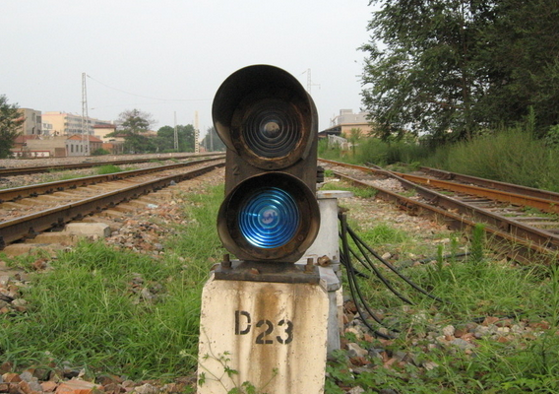
Semaphores
A new variable type, called semaphore, was introduced in 1965, by E. W. Dijkstra (from Holland).
1930-2002
Notes:
荷兰数学家E. W. Dijkstra ，也是Dijkstra算法提出者

Slide 38
Semaphores
Semaphore S - integer variable, can only accessed via two indivisible operations.
  Originally called wait and signal (or P, V operation)
  wait (S): signal (S):
  while (S<=0) S++;
  ; // no- op
  S--;
Notes:
信号量S是个整数变量，除了初始化外，它只能通过两个标准原子操作wait和signal来访问。这些操作原来被称为P（用于wait，表测试）和V（用于signal，表增加）。
在wait和signal操作中，对信号量整数值的修改必须不可分地执行。

Slide 39
Critical Section of n Processes
Shared data:
semaphore mutex; // initially mutex = 1
Process Pi:
do {
wait(mutex);
critical section
signal(mutex);
remainder section
} while (1);
Notes:
可以使用信号量来解决n个进程的临界区问题。这n个进程共享一个信号量mutex，并初始化为1。
也可使用信号量来解决各种同步问题

Slide 40
Implementation of Synchronization
Consider two concurrently running processes:
  P₁ with a statement S₁ and P₂ with a statement S₂.
  S₂ must be executed only after S₁ has completed.
Solution
  Let P₁ and P₂ share a common semaphore synch, initialized to 0
P₁:
S₁;
signal(synch);
P₂:
wait(synch);
S₂;

Slide 41
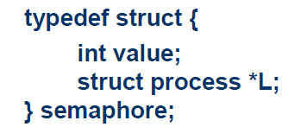
Semaphore implementation
The main disadvantage- busy waiting.
Define a semaphore as
Two operations
  Block operation: block()
    places a process into a waiting queue associated the semaphore.
    The state of the process is switched to the waiting state
  Wakeup operation: wakeup()
    Changes the state of the process from the waiting state to the ready state.
    Places the process in the ready queue.

Slide 42
Semaphore Implementation
Semaphore operations now defined as
wait(S):
S.value--;
if (S.value < 0) {
add this process to S.L;
block();
}
signal(S):
S.value++;
if (S.value <= 0) {
remove a process P from S.L;
wakeup(P);
}
Notes:
一个进程阻塞且等待信号量S，可以在其他进程执行signal操作之后被重新执行。该进程的重新执行是通过wakeup操作来进行的，该操作将进程从等待状态切换到就绪状态。接着，该进程被放入到就绪队列中。

Slide 43
Two Types of Semaphores
Counting semaphore – integer value can range over an unrestricted domain.
Binary semaphore – integer value can range only between 0 and 1; can be simpler to implement.
Notes:
计数信号量：整数值，可跨越于一个不受限制的域内
二进制信号量：值只能是0和1，比计数信号量更容易实现。

Slide 44
Bounded-Buffer Problem
This is the same producer / consumer problem as before. But now we'll do it with signals and waits.
BINARY_SEMAPHORE mutex = 1; // Can only be 0 or 1
COUNTING_SEMAPHORE empty = n; full = 0; // Any integer

Slide 45
Process Synchronization-1 Synchronization Tools

